Slide 1
AUTOMATIC BUS ROUTES
SELECTION USING
MACHINE LEARNING TECHNIQUES
Review-1
TEAM MEMBERS:-
V SaI Amruth(180330286)
N Sudheer Reddy(180330154)
B sai charan(180330248)
Team Supervisor:
Ms Madhu Priya

Slide 2
Abstract
This project helps the new business people who are ready to start their local buses transportation in metropolitan cities and it also helps the existing local buses transportation to run their buses in minimal locations to avoid losses

Slide 3

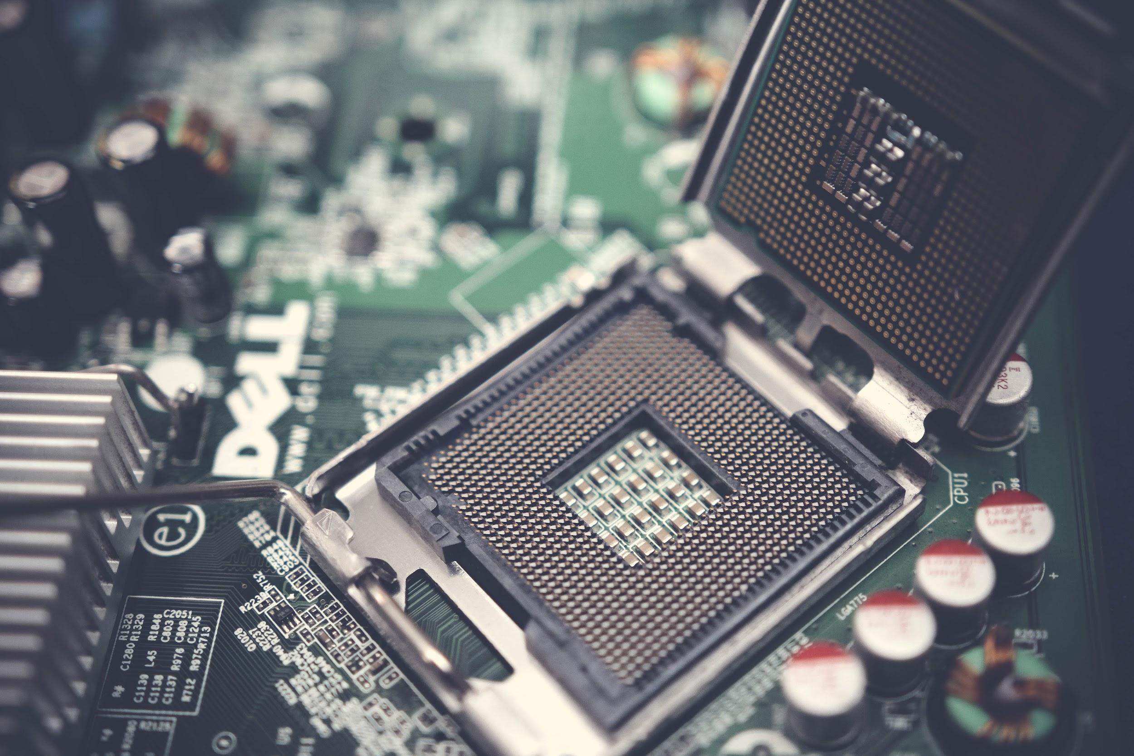
Software and Hardware requirements
Hardware:
.Processor: AMD Ryzen 5 4500U with Radeon Graphics 2.38 GHz
.RAM:8.00 GB
.Operating System: Windows 11
.64-bit operating system, x64-based processor
Software:
.Python 3.8 And Packages
.Google colab
.Google forms
.Pycharm,Git

Slide 4
Functional Requirements
After developing this application Manager should be able to access their system such that he should know the bus can run or not in the path
Tracker Application. Calculations required for this application are all related to past data & Data processing is done by using different python libraries like pandas

Slide 5
Non - Functional Requirements
Maintainability
Reliability
Extensibility
Portability

Slide 6
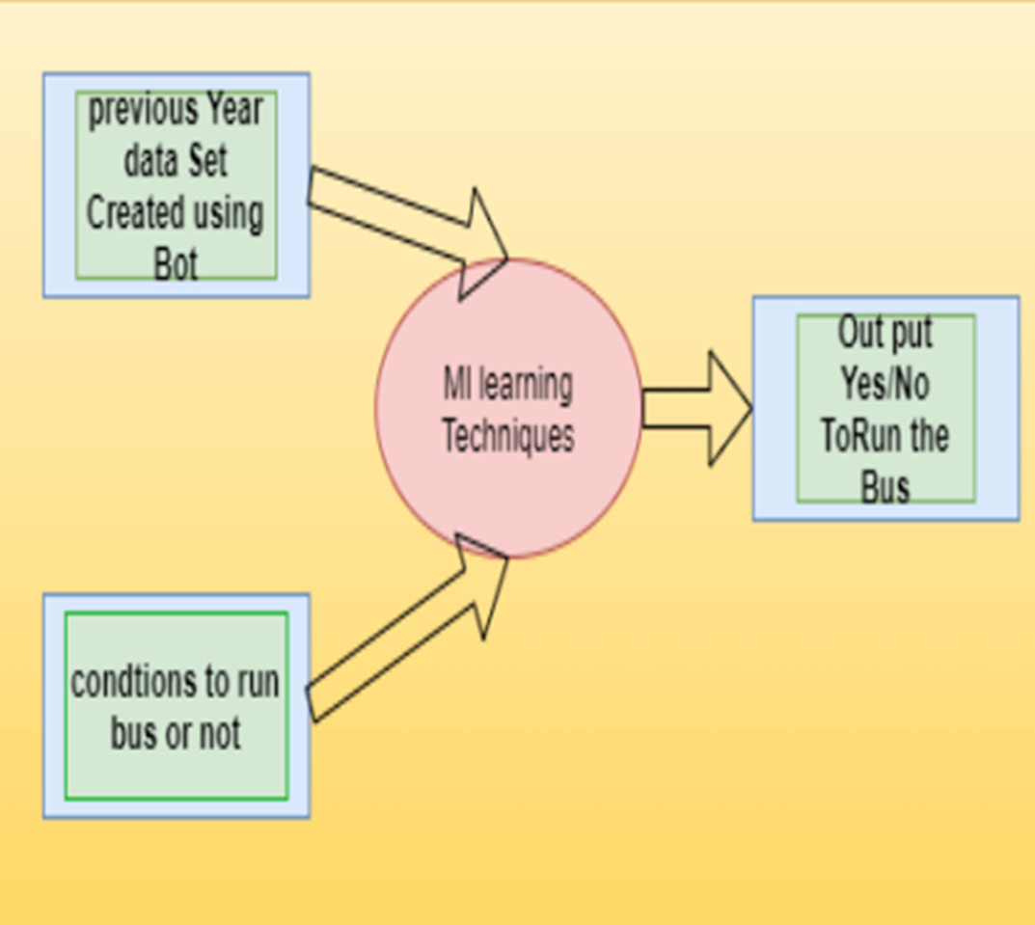
Design :

Slide 7
WORK DONE TILL DATE
Identified the different parameters to create data set
Created the data set using google form based on the identified parameters by creating a bot using selenium package
Applied some Ml techniques and predicted should we run a bus or not in a particular start and end location

Slide 8
PARAMETERS IDENTIFIED
Occasion types (exam,festival,event,weekdays)
Start Location (1-40 location like(jbs,mgbs….)
end location (1-40 location like(jbs,mgbs….)
Season types (sunny,rainy,winter)
Time types (Morning,Afternoon,evening)
no of tickets (Tickets sold in one Trip)

Slide 9
CREATION OF DATA SET
As,we need huge amount of data to predict the no of tickets Accurately,so manual filling will take lot of time to predict ,So we Have Created a Bot using selenium package in python,and we have collected the necessary data https://forms.gle/cCQiNQFCUufvKjjx7
Generated Data Set https://drive.google.com/file/d/1Hjjjk3YALRhd1fLibBTAUadfgp0lXOqB/view?usp=sharing

Slide 10
ML TECHNIQUES USED
As we have data in the form numerical data and labeled data so we have used regression Analysis to predict the bus should run or Not
To perform regression analysis we have used different regression technique like linear_model ,GradientBoostingRegressor ,Linear Regression etc
By using the regression analysis we have predicted sample output

Slide 11
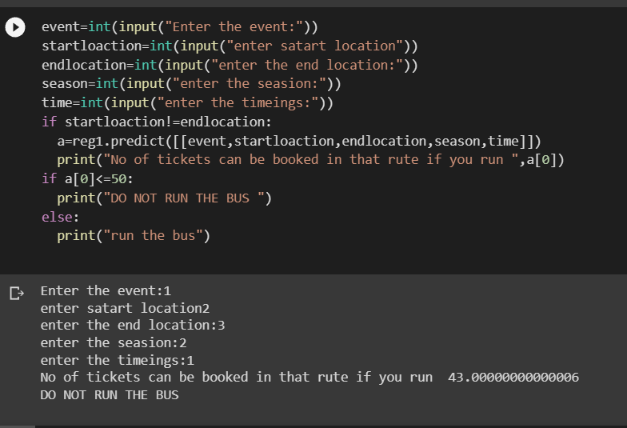

Slide 12


Slide 13


